Slide 1
Order of Importance
Brenda
Pedro &
Nick

Slide 2
Definition:
Organizing information according to it’s importance.
Ascending and descending
Ascending: From least to most important. Best for hostile readers
Descending: From most important to least, catches readers attention.

Slide 3
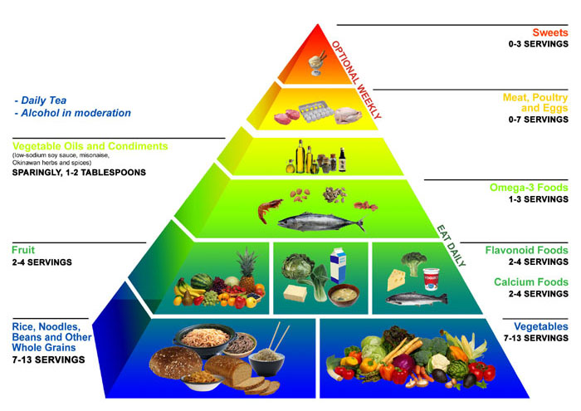
Important Foods
Notes:
This one depends on how your read it

Slide 4
Descending
Delicious cake
Cake Mix
eggs
sweets
sprinkles
frosting
milk
oil

Slide 5
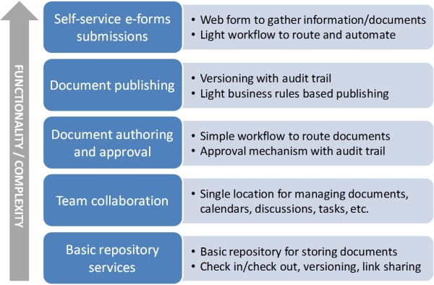
Ascending Order

Slide 6
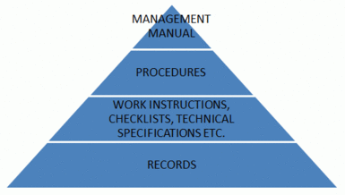
Descending Order

Slide 7
Cites:
http://www.google.com/search?hl=en&safe=active&tbo=d&biw=1280&bih=690&tbm=isch&sa=1&q=food+pyramid&oq=food+pyramid&gs_l=img.3..0l10.42551.50717.0.51118.21.15.1.5.5.1.229.2242.2j10j2.14.0...0.0...1c.1.6SMmdpQJ65A
http://www.netcoach.eu.com/index.php?id=79
http://aspe-it.com/blog/2012/sharepoint-and-document-management-core-document-management-use-cases/

